Slide 1





Online Nuclear Dilemma-2
Local Area Turner
Team Arkansas
Team Members
Md Mohi Uddin Khan
IUT | EEE
Rezuanur Rahman Dip
IUT | EEE
Farhan Shahriyar Haq
IUT |EEE
Faisal Hossain Reevu
IUT | EEE

Slide 2


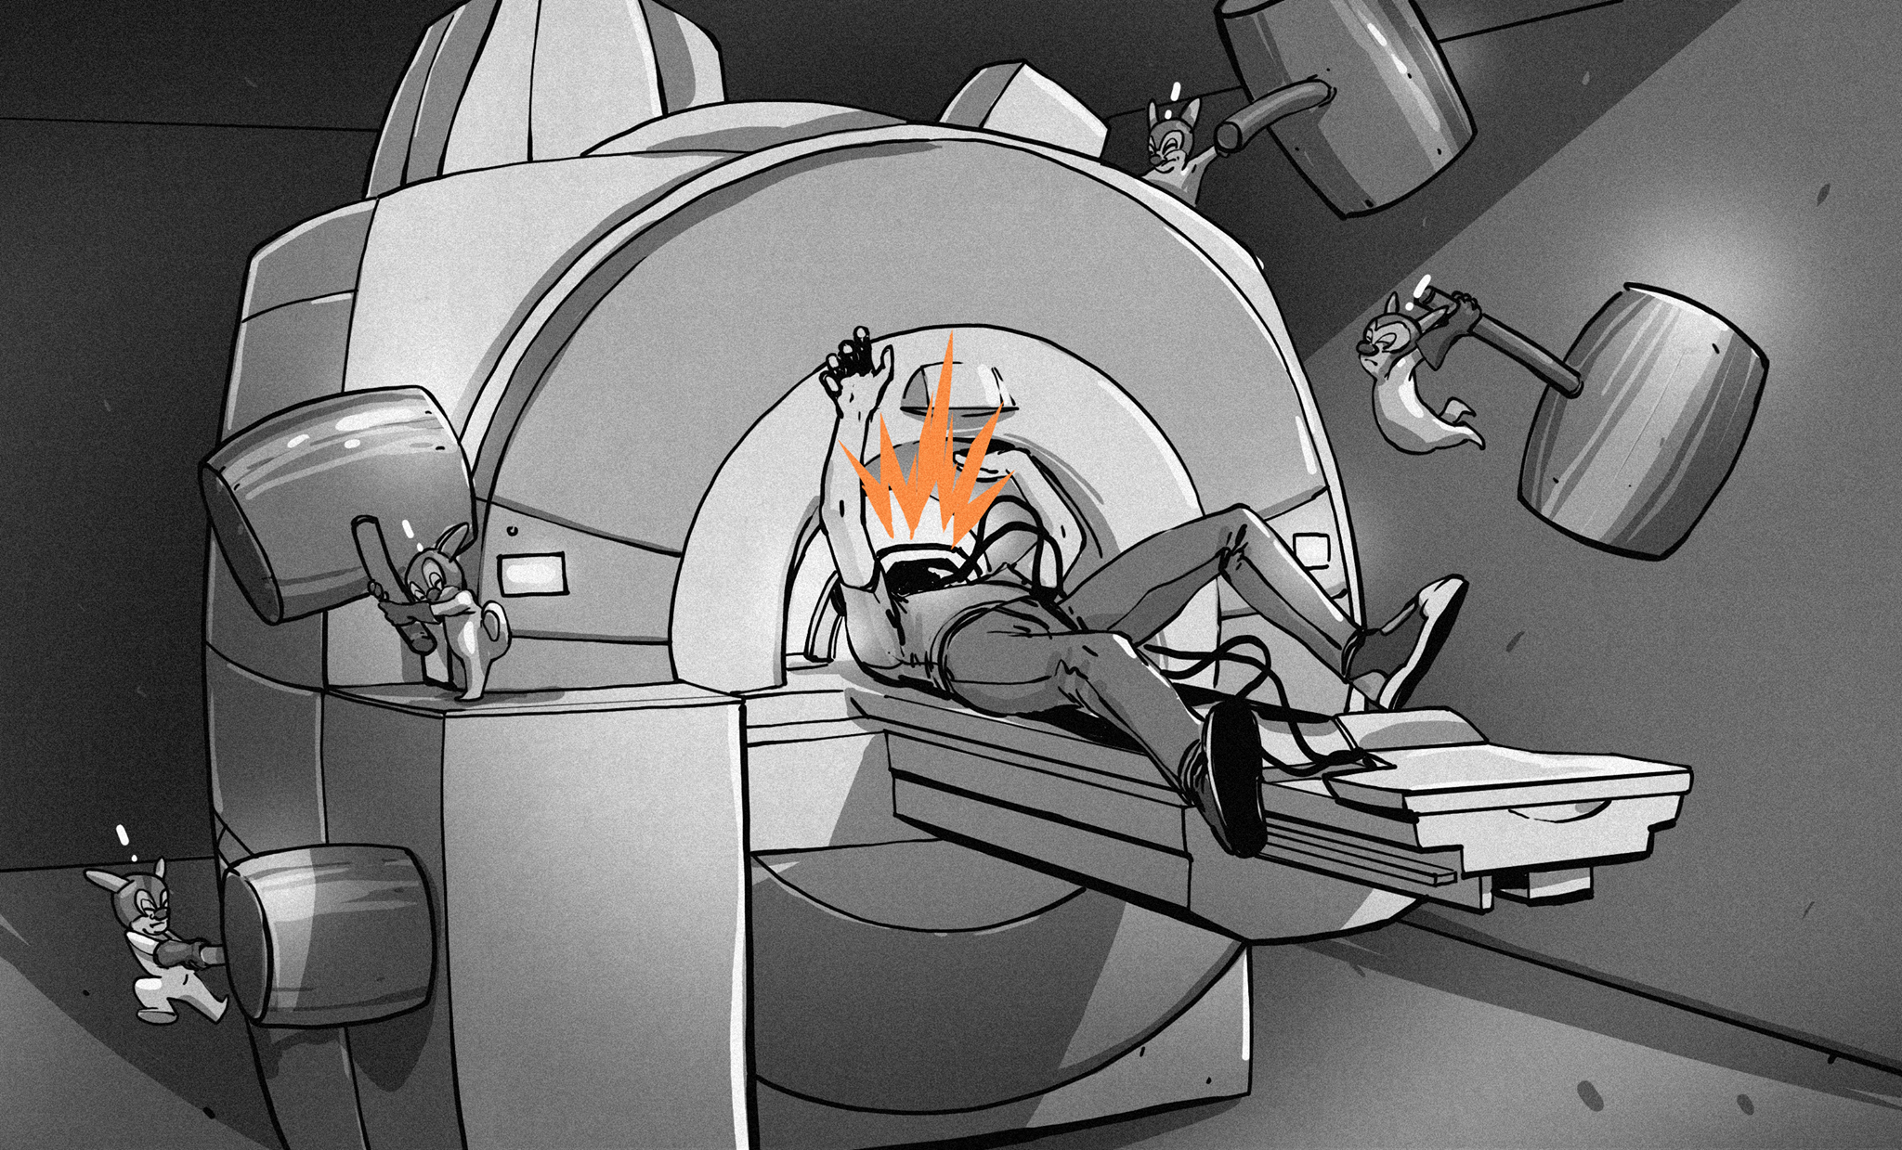
Radiation !
A positron emission tomography (PET) scan is an imaging test that uses radioactive tracers. These tracers are either swallowed, inhaled, or injected into a vein in arm depending on which part of the body is being examined. Certain organs and tissues then absorb the tracer. It’s possible to have an allergic reaction to the tracer due to gamma radiation from positron.

Slide 3
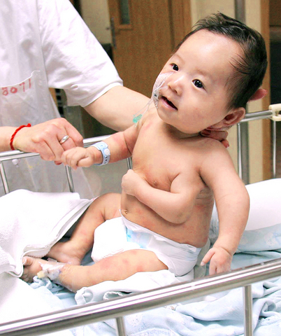
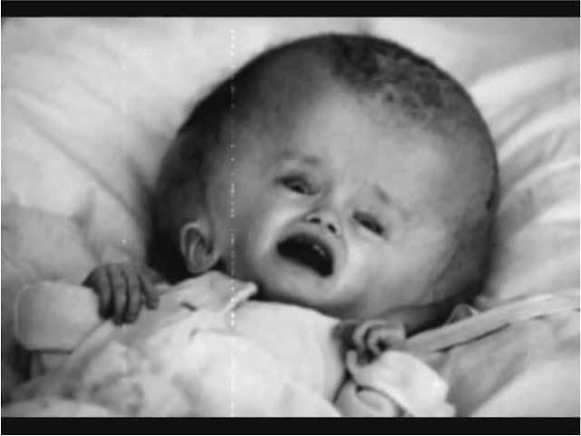
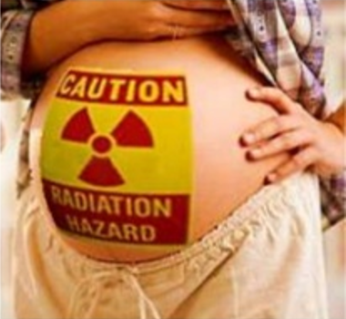
A Threat to Pregnant Women
Radiation is dangerous to embryo & fetus development. Breastfeeding is risky for 24 hours following the PET scan.

Slide 4

Side Effects
05
01
03
Flushing
Nausea
Headache
06
02
04
Mild Rash
Vomiting
Itching

Slide 5

Very Expensive ! ! !

Slide 6
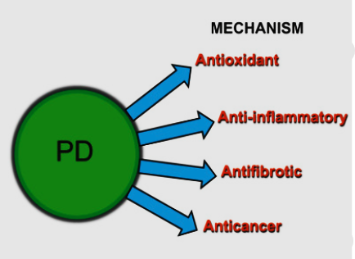
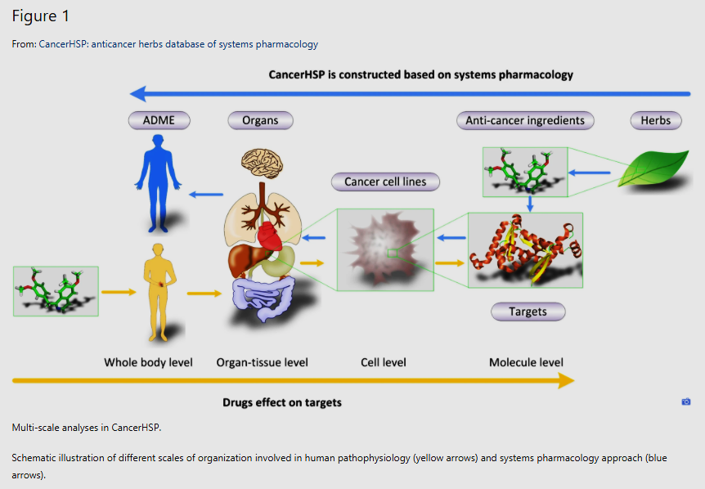


Herbal Medicines have gained popularity as potential therapeutic agents for the prevention of diverse illness due to their high efficacy & low side effects. Plant drugs (PD) contribute to health in many ways:

